Slide 1
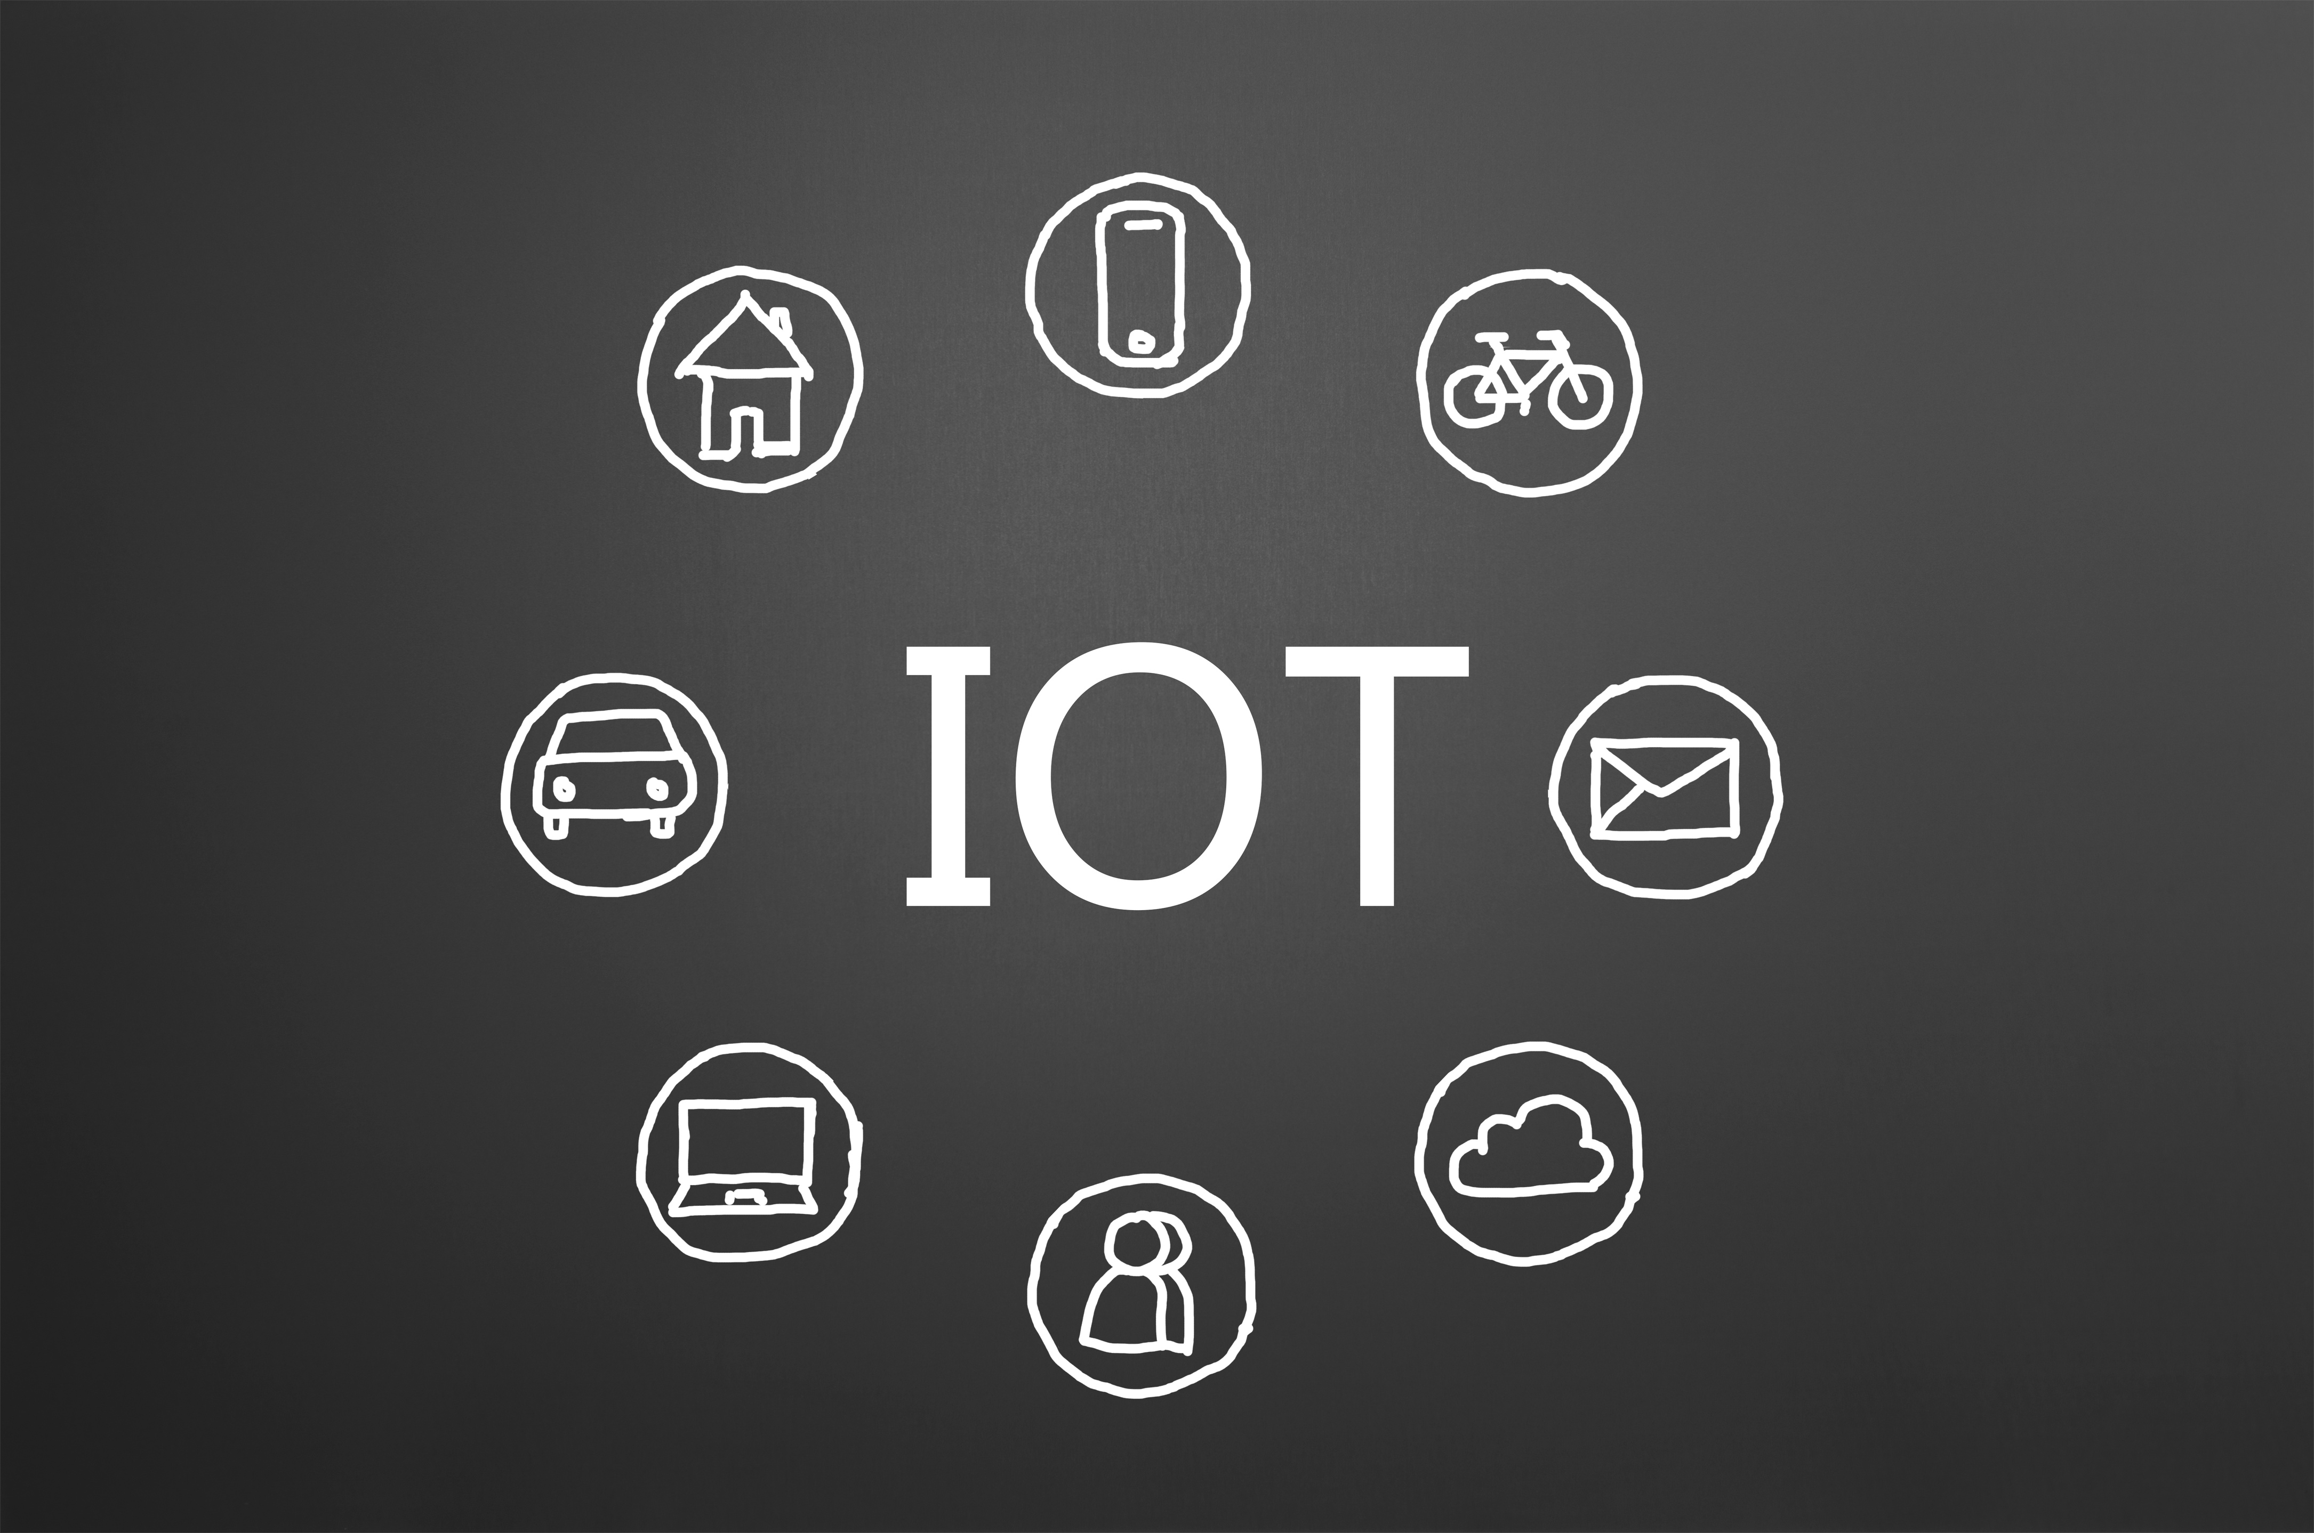





Smart IoT safe
Graduation project 2

Slide 2









INTRODUCTION
High-Value Security Context
Gold and jewelry stores manage critical assets requiring robust security beyond physical barriers.
The IoT Paradigm Shift
Transitioning from Passive Security (locks and CCTV) to Active Monitoring using the Internet of Things (IoT).
Project Vision
Designing a Cyber-Physical System that integrates embedded sensors with secure cloud infrastructure to protect assets in real-time.

Slide 3









OBJECTIVES
Where We’ll Engage Our Audience
Real-Time Detection:
Cloud Integration (AWS):
Develop a system to detect vibration, motion, and unauthorized access instantly.
Utilize AWS IoT Core for scalable, secure data processing and device management.
Global Tracking:
Instant Notification:
Implement GPS technology to provide real-time location updates if the safe is moved.
Deliver immediate alerts to the owner via a Telegram Bot to ensure rapid response time.

Slide 4








PROBLEM STATEMENT
Lack of Interactivity:
Traditional safes are "offline" devices; they cannot communicate threats to the owner.
Delayed Response:
Theft incidents are often discovered hours or days later, drastically reducing recovery chances.
No Tracking Capability:
Once a safe is physically removed from the premises, its location becomes untraceable.
Local Dependency:
Reliance on local alarms that can be easily disabled or bypassed by intruders.

Slide 5
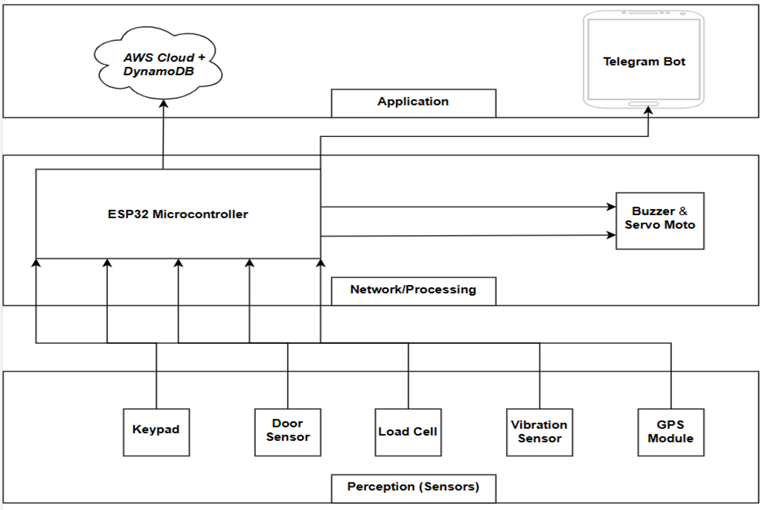

SYSTEM ARCHITECTURE

Slide 6
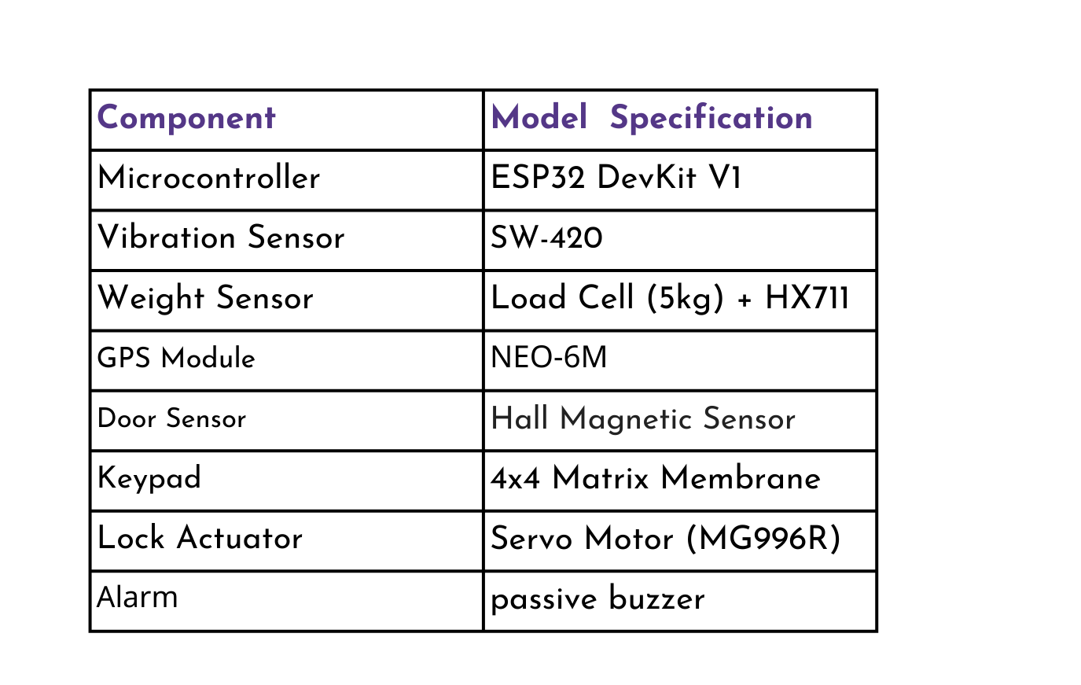
HARDWARE SPECIFICATIONS

Slide 7
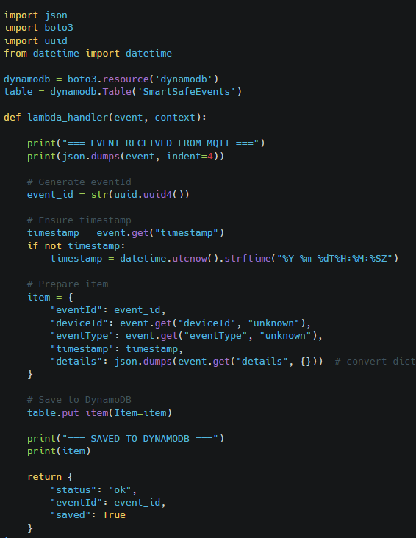
CLOUD ARCHITECTURE & DATA FLOW
INGESTION&ROUTING
Protocol: Utilized MQTT for lightweight, secure communication via TLS 1.2.
Rules Engine & Alerts: Configured SQL-based rules (SELECT * FROM 'safe/events') to:
Route data to the processing layer.
Trigger Amazon SNS immediately for cloud-based notifications if a theft condition matches.
PROCESSING LAYER (SERVERLESS LOGIC)
AWS Lambda: Deployed a Python function to parse incoming JSON events, generate unique IDs (uuid), and timestamp data securely.
Backend Logic: The function acts as the bridge, processing raw signals before committing them to the database.

Slide 8
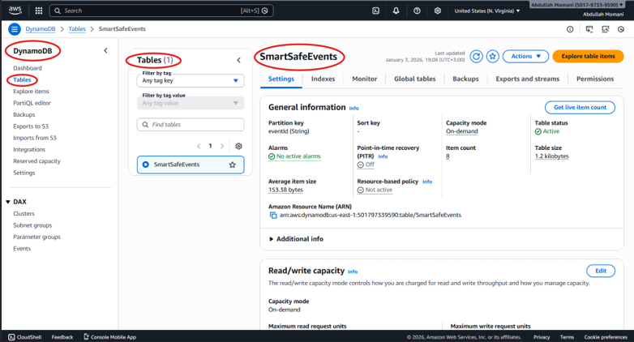
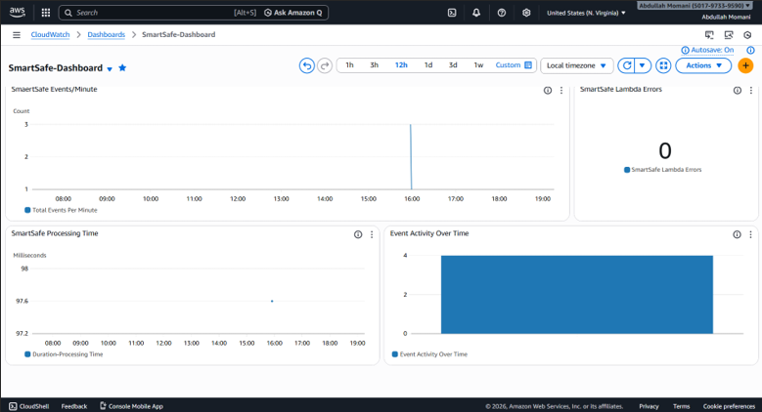
CLOUD ARCHITECTURE & DATA FLOW
STORAGE & VISUALIZATION
DynamoDB: Implemented a NoSQL database with "On-Demand" capacity (Pay-per-request) to store event logs scalably.
CloudWatch: Set up for real-time monitoring of system health and Lambda error logging.

Slide 9
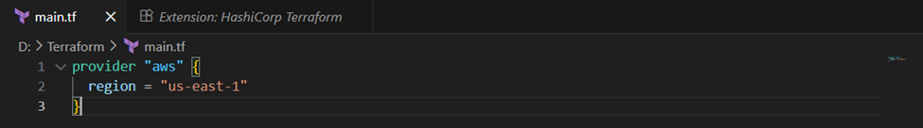

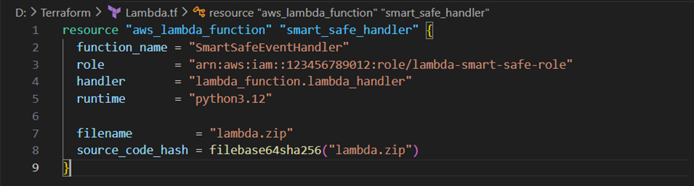
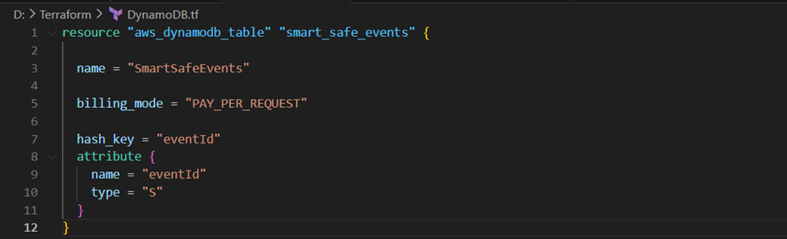
INFRASTRUCTURE AS CODE(IAC) TERRAFORM:
Automated Deployment
Defined the entire cloud infrastructure (Lambda, Roles, DynamoDB Tables) using Terraform configuration files
Reproducibility::
This approach ensures the environment can be destroyed and re-deployed in minutes without manual configuration errors
Resource Management:
Managed AWS permissions (IAM Roles) and Lambda triggers programmatically to ensure strict security compliance

Slide 10
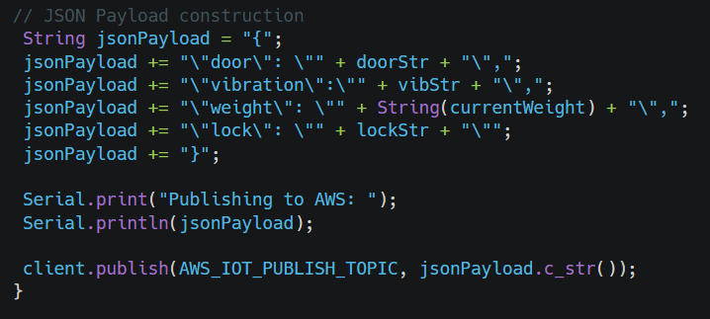

COMMUNICATION & SECURITY
HTTPs Protocol
Used by ESP32 to send direct secure requests to the Telegram API for instant alerts.
MQTT Protocol:
Used for lightweight data streaming to the AWS Cloud
TLS 1.2 / SSL:
Ensures all direct communications (to Telegram or AWS) are encrypted
JSON Payloads:
Structures the sensor data efficiently for fast parsing by the cloud functions.

Slide 11

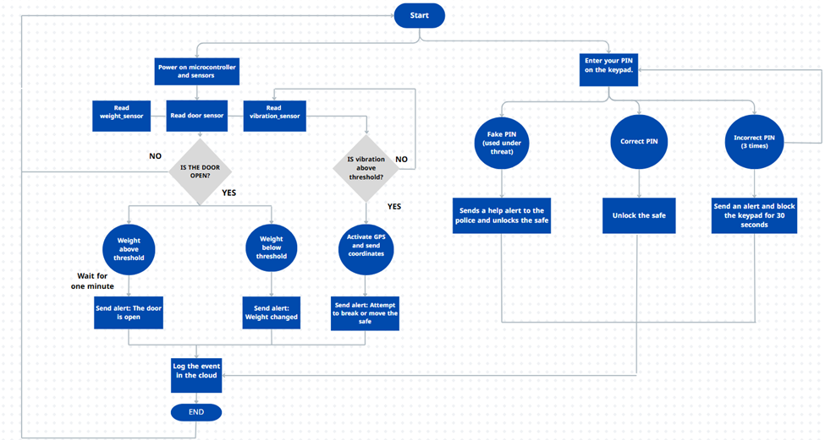

WORKFLOW

Slide 12











STRENGTHS
Situational Awareness
Theft Detection
Cost-Effectiveness
High Availability & Scalability

Slide 13









LIMITATIONS
Power Dependency
Internet Dependency

Slide 14







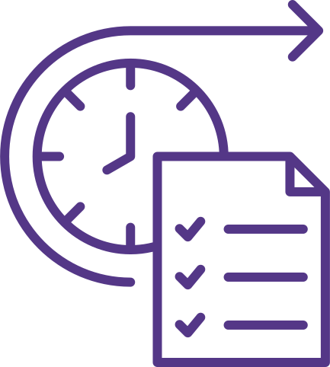



FUTURE WORK:
Visual Evidence: Integrate an ESP32-CAM to capture and send the thief's photo instantly.
AI Integration: Implement Machine Learning (TinyML) on the edge to distinguish between accidental bumps and drilling/cutting sounds.
Biometric Access: Replace keys with Fingerprint or FaceID for authorized access.
Centralized Monitoring Dashboard:

Slide 15








CONCLUSION
Mission Accomplished:
Technical
Success:
User
Experience
The
Outcome:
Successfully bridged the gap between physical security and digital intelligence, transforming the safe from a "passive box" to an "active guardian."
Proved that Serverless Cloud Architecture (AWS) offers superior reliability, security, and speed compared to traditional local systems.
Designed a seamless, user-friendly interface via Telegram, allowing owners to monitor status and receive instant alerts remotely without complex software.
Delivered a fully functional, cost-effective prototype that empowers business owners with real-time control and peace of mind.

